Slide 1
E COMMERCE PIPELINE PROJECT
Given by board infinity by aBhishek gole

Slide 2
INDEX
Data pipeline flowchart.
Mysql commands as 1st output.
Sqoop commands as 2nd output.
Hive commands as 3rd output.
Hive query as 4th output.
Documentation as 5th output.
Thank you.

Slide 3






Data pipeline flowchart.
Hive query

Slide 4
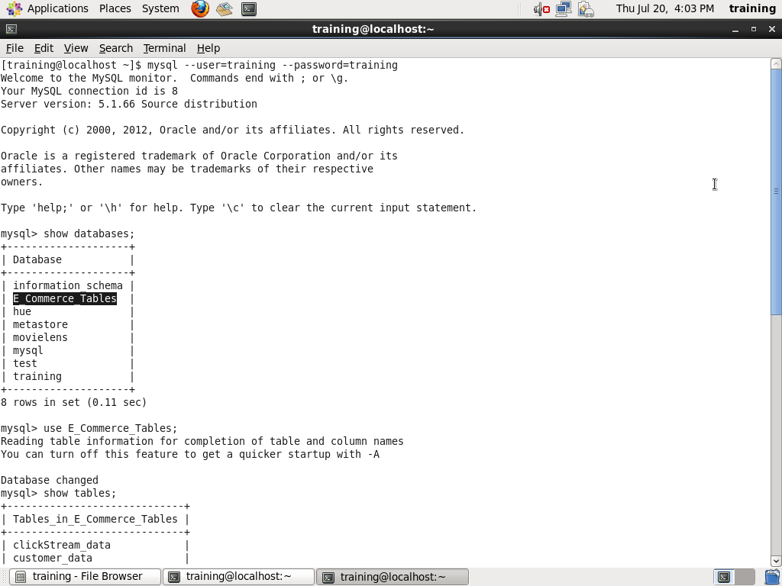
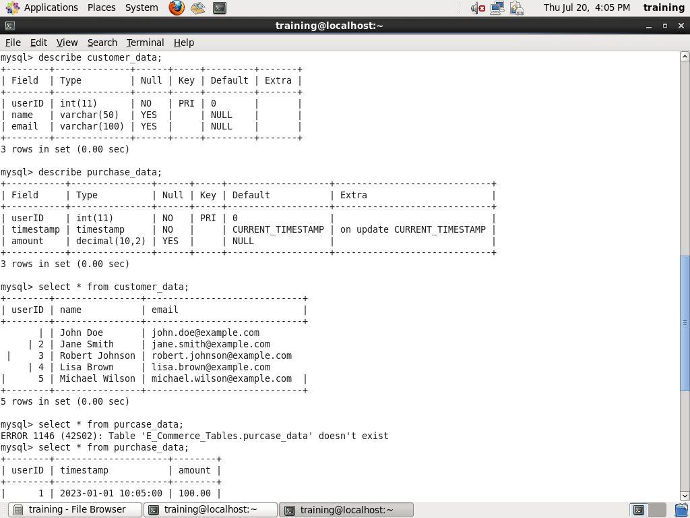
Mysql commands as 1st output.

Slide 5
Commands
OUTPUT 1 . sqoop import \> --connect jdbc:mysql://localhost/E_Commerce_Tables \> --table clickStream_data --fields-terminated-by ',' \> --username training --password training. sqoop import \> --connect jdbc:mysql://localhost/E_Commerce_Tables \> --table clickStream_data --fields-terminated-by ',' \> --username training --password training.. sqoop import --connect jdbc:mysql://localhost/E_Commerce_Tables --table purchase_data --fields-terminated-by ',' --username training --password training

Slide 6
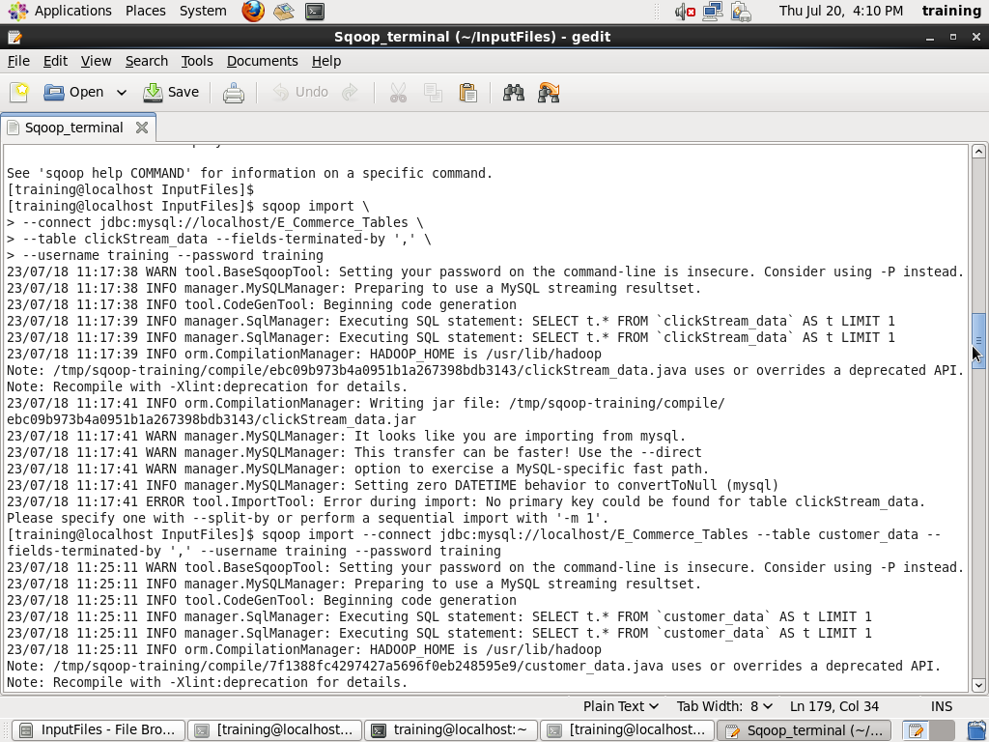
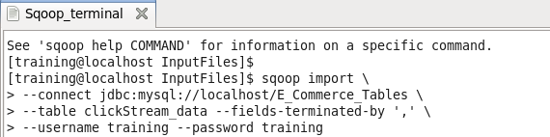
Sqoop commands as 2nd output.
Import commands
Running command

Slide 7
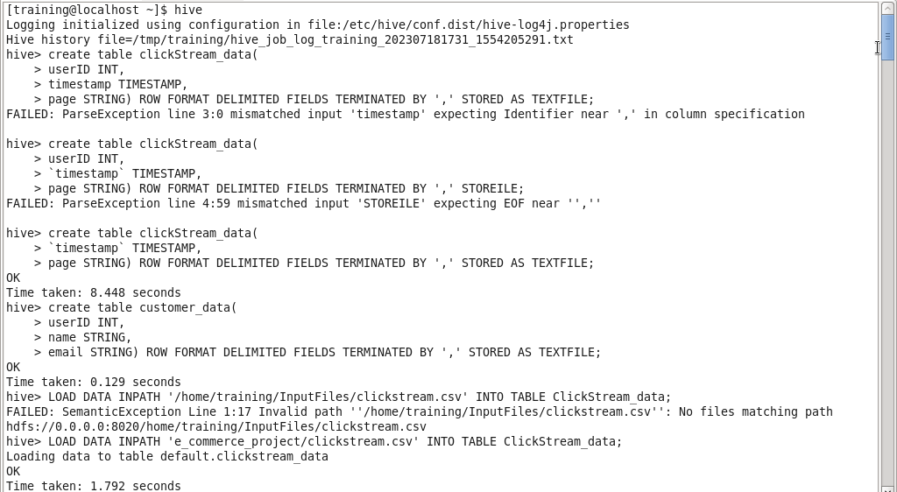
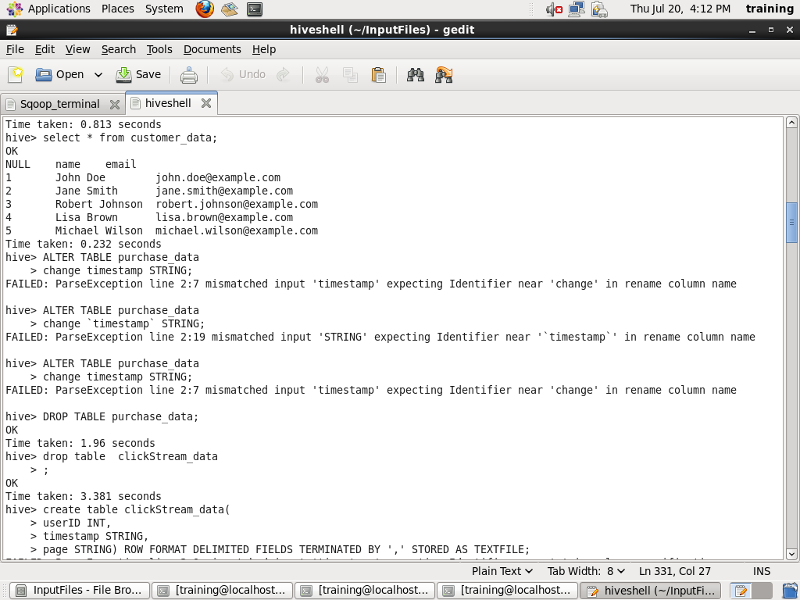
Hive commands as 3rd output

Slide 8
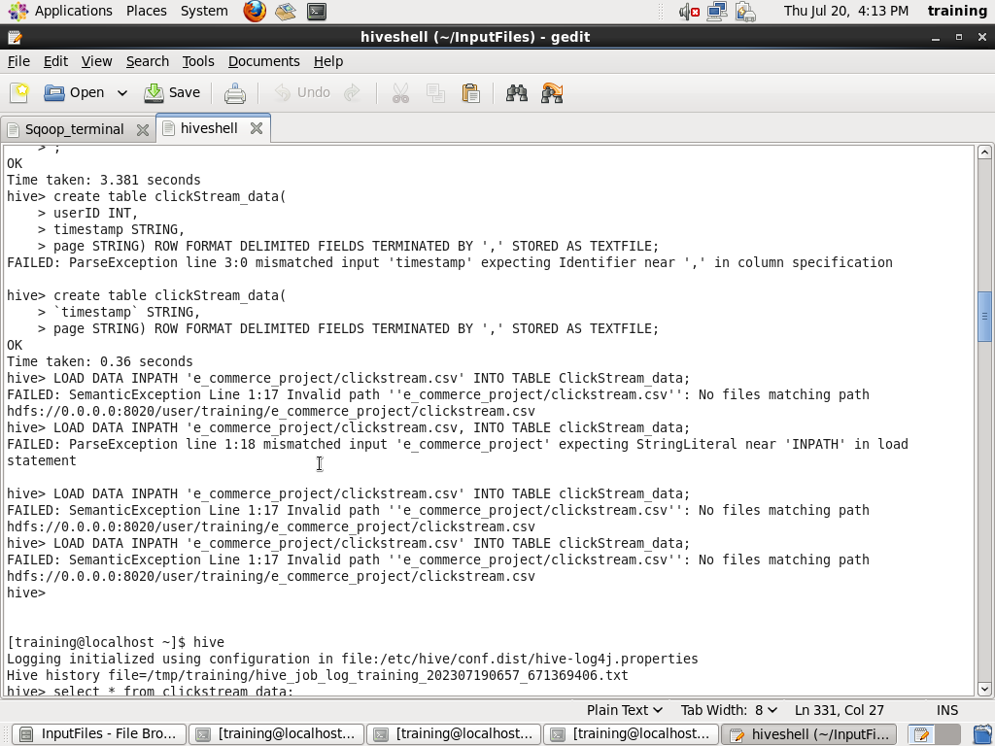
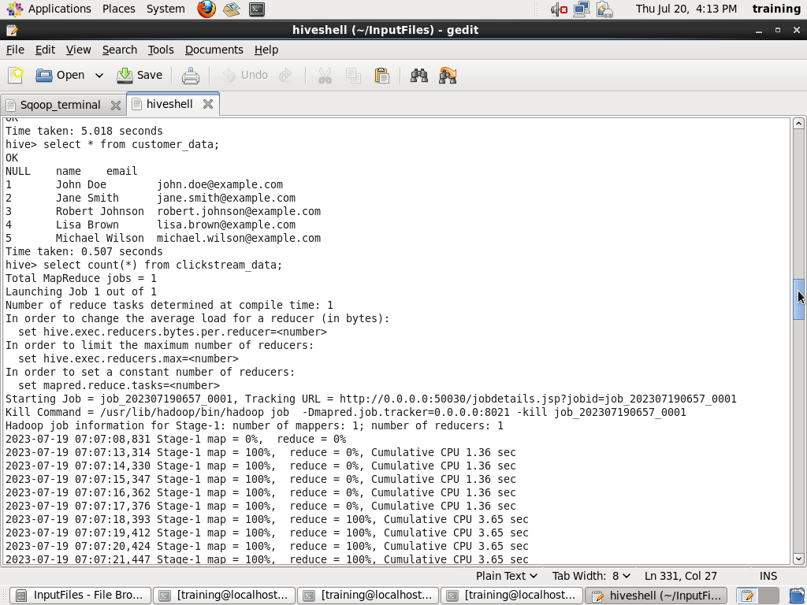

Slide 9
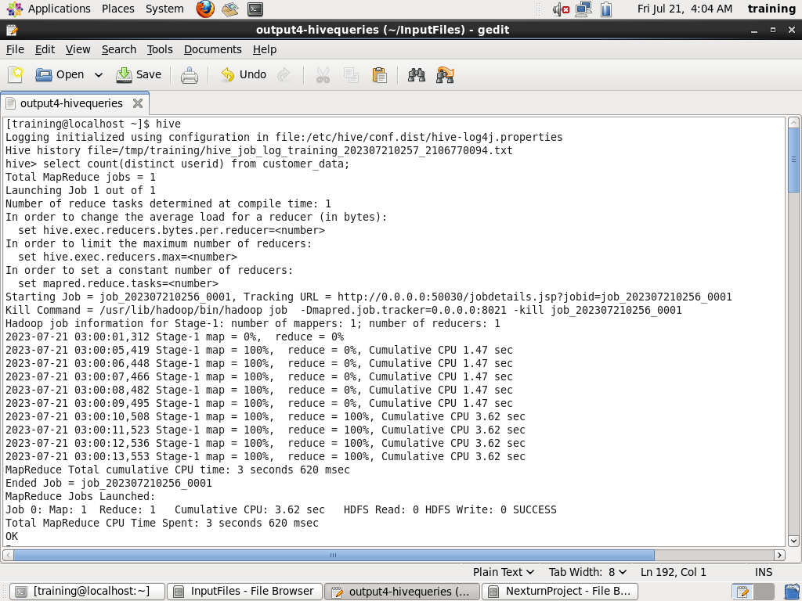
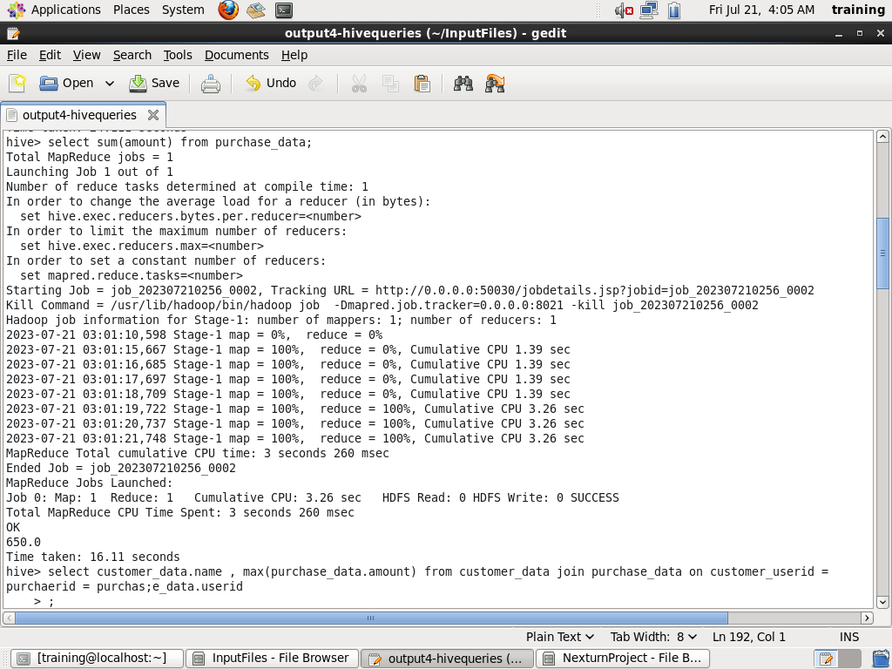
Hive query as 4th output

Slide 10
